Slide 1
E-Commerce Website: QuickBasket
Mirafra Technologies
Presented By: Sam Christopher K
Date: 29/04/2025

Slide 2
Introduction:
QuickBasket is a modern, responsive e-commerce web application built with React.js, offering an intuitive and seamless shopping experience.
Objective:
Real-time product filtering via search box
Secure user authentication and session handling
Dynamic cart with item management
Invoice generation and download functionality
Fully responsive design across all devices

Slide 3
Software Requirements
Frontend: HTML, CSS, JavaScript, React.js
Backend: JSON
Tools: VS Code, Git, GitHub
Hardware Requirements
Processor: Intel i5 or higher
RAM: Minimum 4GB
OS: Windows / Linux / macOS

Slide 4
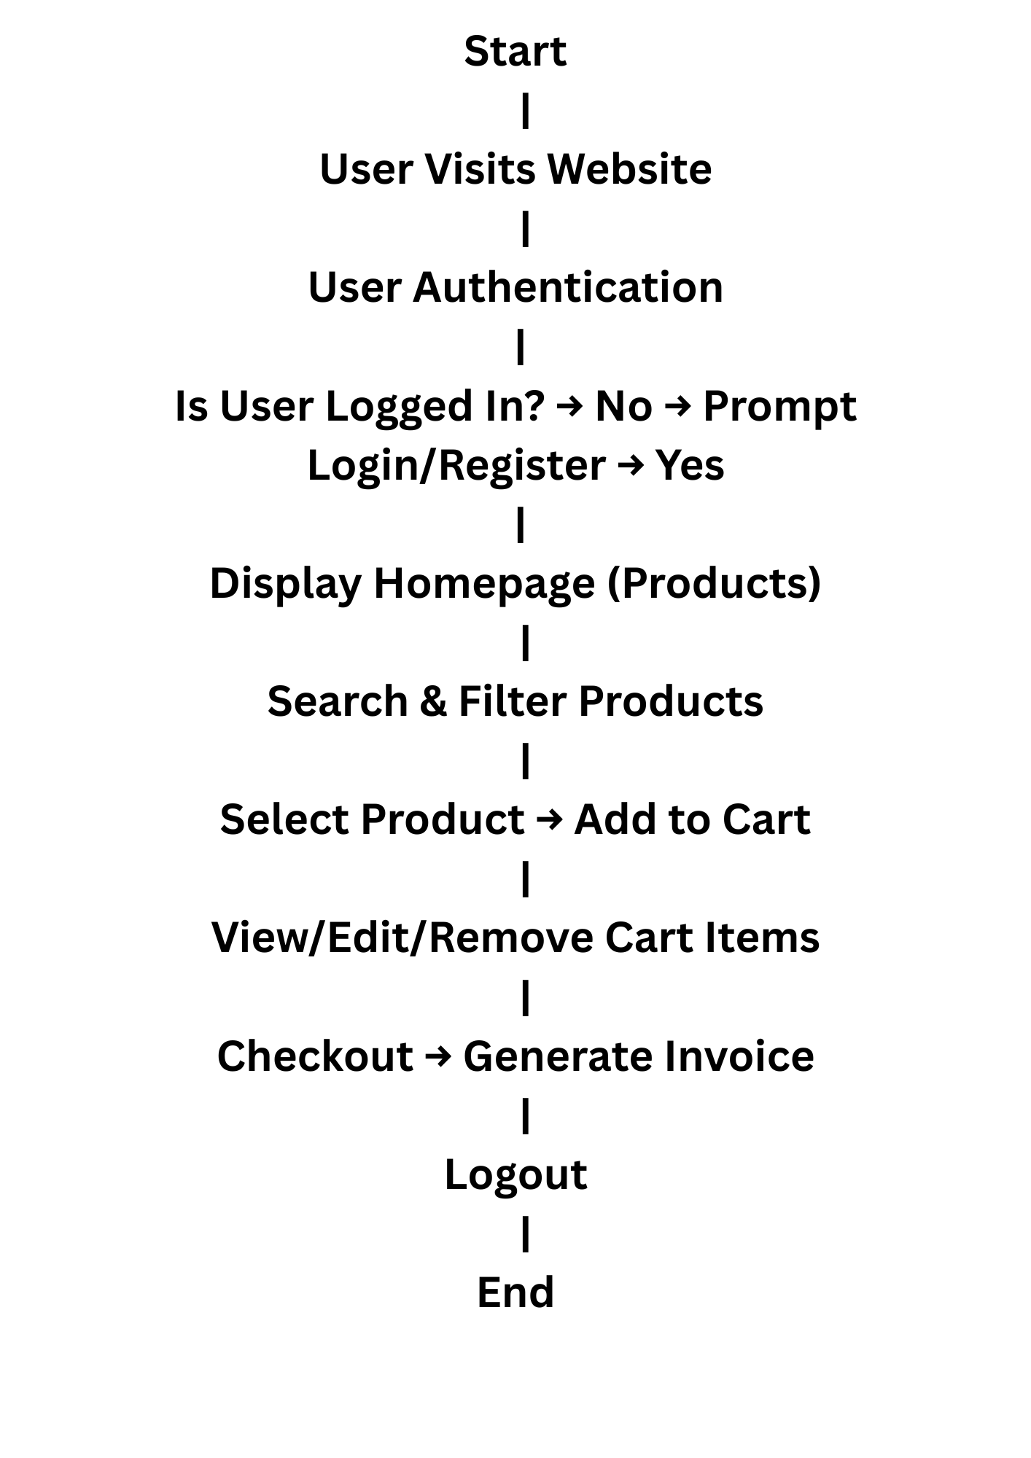
Workflow:

Slide 5
Future Scope:
Integration with backend APIs and databases
Secure login & registration features
Real-time inventory and order tracking
Payment gateway integration
Admin dashboard for managing products and users

Slide 6


